Slide 1
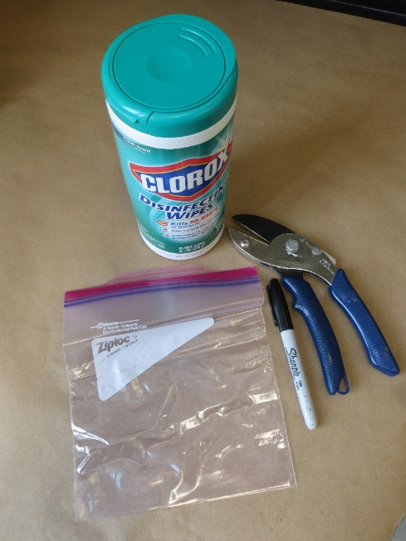
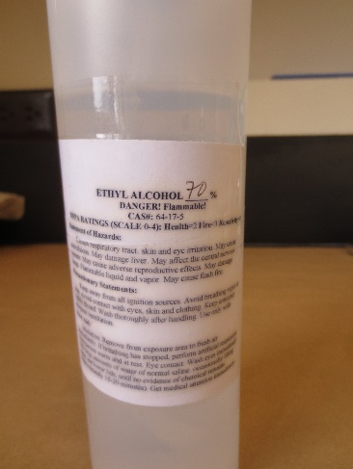
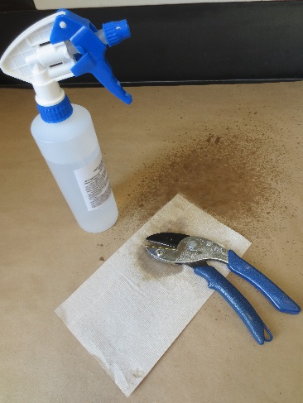
Sample Collection Needs
-Shears, clippers or a knife to collect tissue
-Disinfecting wipes or sanitizer and disposal paper towels to wipe tool blades between plants
-Plastic bags to hold samples (one sample or plant per bag only)
-Permanent marker to label samples
-Access to a cooler or refrigerator to store sample(s), if needed
Instructions/Handling:
It may not be likely that you have ready access to a boxwood shrub with boxwood blight at the time that you wish to perform this training. We suggest scouting various boxwood plantings that you may have access to and looking for any potential foliar or twig symptoms, and collect tissue exhibiting a wide range of symptoms. Collect samples 1-3 days before the class.
As you plan for the class, you may also ask participants to consider bringing in a fresh sample from a boxwood planting (that they may legally access) to share with the class.
Whatever the source of the tissue, at a minimum, you will want to have at least one small symptomatic branch or stem section that is a minimum of 4 inches long, and still has some intact leaves, for each pair of participants. Be certain to disinfect your pruning tools between plants!
Place samples from individual plants in separate sealed plastic bags and label each bag with a permanent marker, including sufficient information for sample identification in case you want to re-examine the same plant.
Store samples collected from individual plants in separate sealed plastic bags in the refrigerator until class. Include a slightly damp (very well wrung out) paper towel to provide minimal moisture.

Slide 2
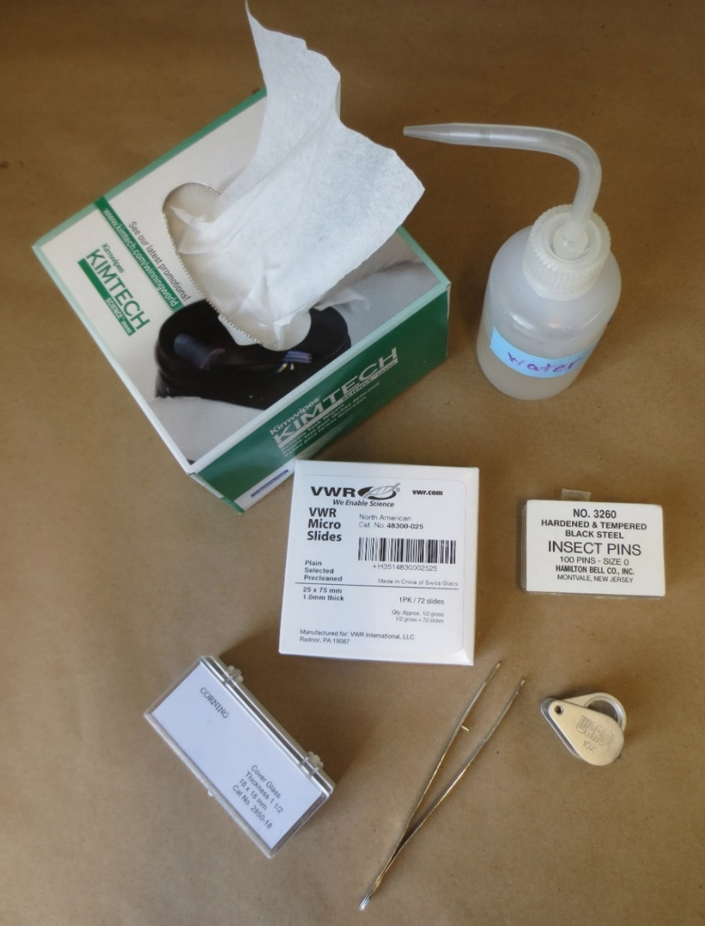
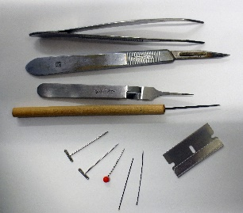
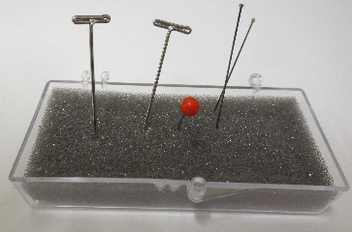
Sample Processing: Supplies & Use!
Disposable paper towels or wipes: Place small sample on a disposable wipe to view under the dissecting microscope. This helps to make moving the sample easy, limits the mess if leaves are falling off, and keeps spores off your microscope stand.
Tweezers or forceps: You can use one to pull individual leaves off of the tissue to take a closer look. It doesn’t hurt to have two pairs –one to hold the sample and another to pick off the desirable tissue.
Fine tip water bottle or eye dropper: Use this to limit how much water you add to the slide. Too much water and the cover-slip may push your sample right off of the slide!
Microscope slides and cover slips: We do suggest the smaller cover slips so you can use about 3 per slide.
Don’t forget the microscopes!
Other items that may come in handy…
A hand lens or magnifying glass to scan a larger sample for symptomatic tissue.
Small tip dissection tools such as insect pins or needles. Be sure to have a pin cushion so you can keep track of these while you work!
A scalpel with fine tip blade or single edge razor blade is not just useful to pick up small bits of tissue but handy of you need to cut away excess plant tissue to be able to focus on a smaller area.
Small dishes with clear lids if you need to set up tissue in a moist chamber to re-examine later.

Slide 3
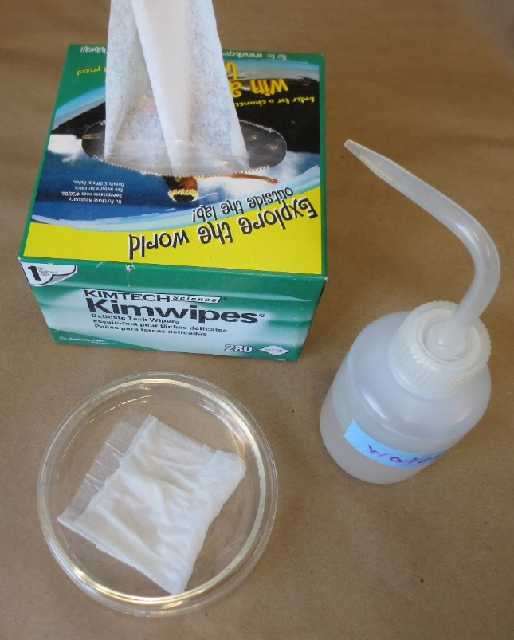
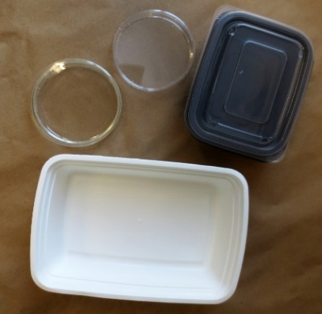
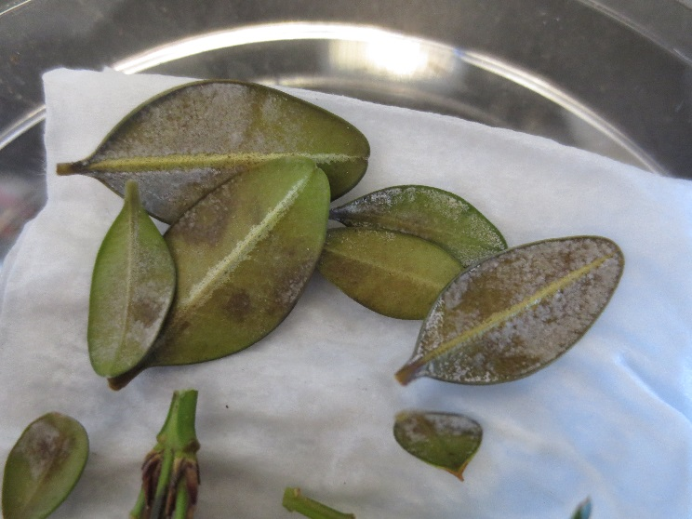
Setting up a Moist Chamber for Boxwood Blight
If you cannot confirm the presence of the pathogen from a fresh sample, set up at least one moist chamber containing tissue exhibiting suspect symptoms of the pathogen.
Do this no more than 1-3 days before you know you will be able to re-examine the tissue.
If symptoms are good and tissue can be examined daily, a single moist chamber with symptomatic tissue may be adequate. If you know you can’t get back to the sample for a few days, it may be best to set up two or more moist chambers. If you have adequate tissue set up moist chambers to incubate at different temperatures.
For large samples, use containers such as plastic bins with good lids; containers do not need to be airtight for the incubation process but need to preserve high humidity.
In one or more container(s), fold and place a small “Kimwipe” or paper towel in the bottom of the container. Dampen slightly with water. Using tweezers, pull individual leaves exhibiting dark spots from the branches, and place them bottom side up in the moist chamber(s). If small twigs show dark lesions, small twig sections can also be included.
It is okay if there is some overlap of individual leaves, but try to avoid a pile of leaves.
Notes:
Handout: Setting up a moist chamber

Slide 4
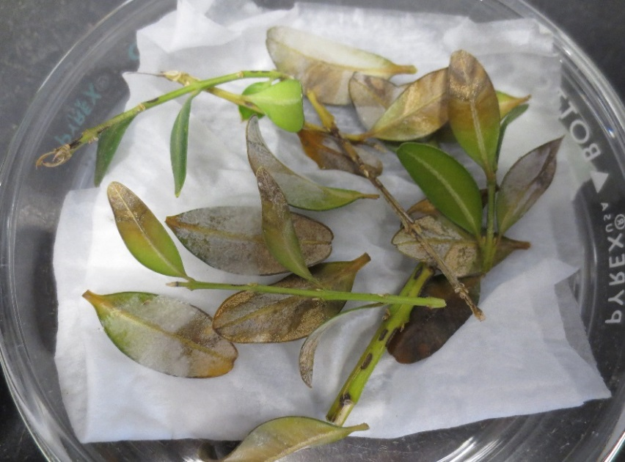
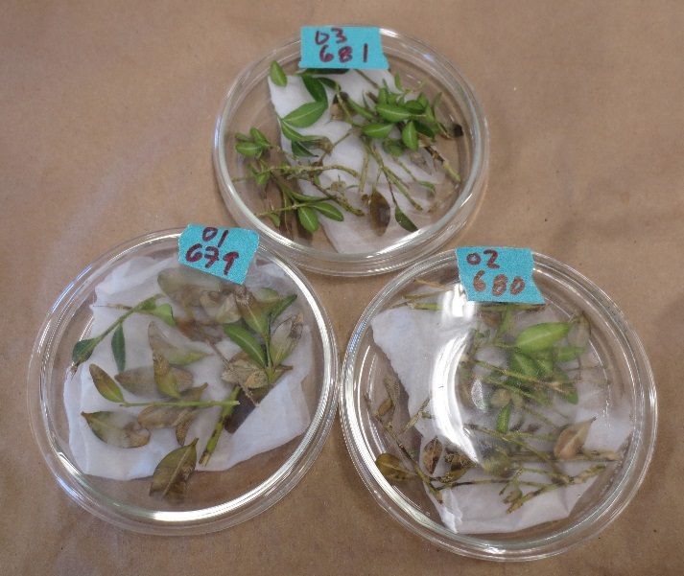
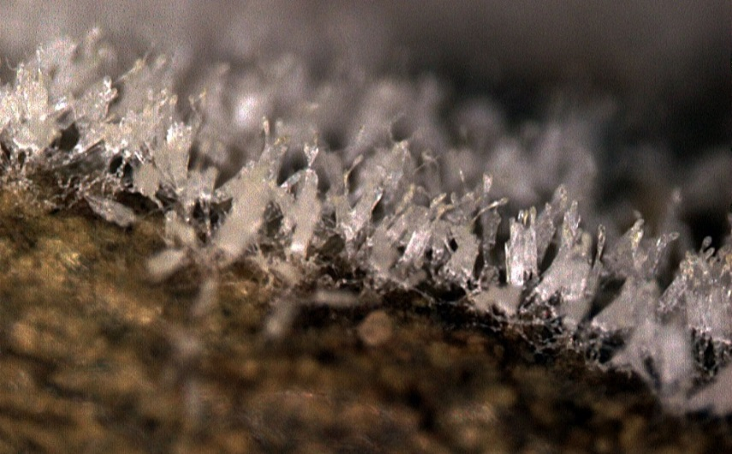
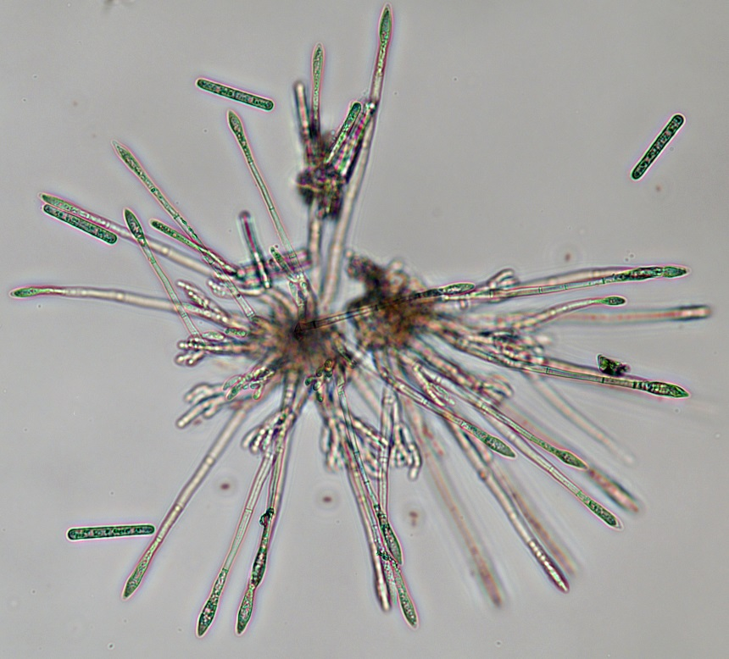
If setting up samples from more than one plant or location – don’t forget to label each separate sample!
The fungus readily grows at temperatures between 41º and 86º F., but temperatures in the 70’s may produce the best sporulation.
Examine tissue daily, if possible, for evidence of sporulation. On the right from top to bottom see: white mycelium on leaf tissue, below that a close view of the cylinders of spores on the leaf surface, and at the bottom a squash mount of a cluster of conidiophores showing cylindrical spores and diamond-shaped vesicles.
Areas that appear salmon or pink in color may indicate that Volutella or other fungi are present.

Slide 5
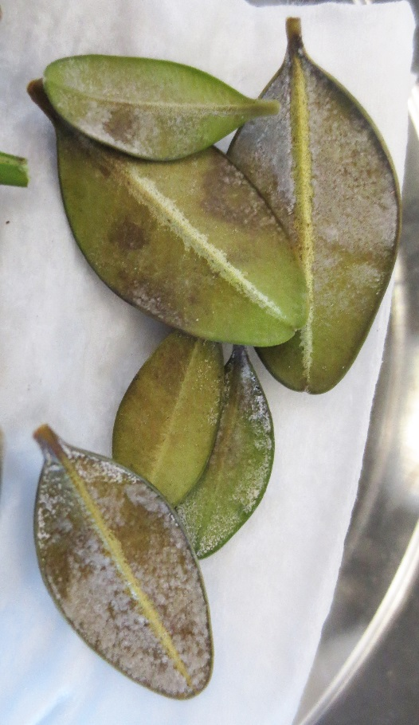
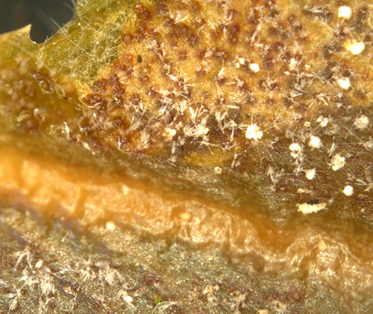
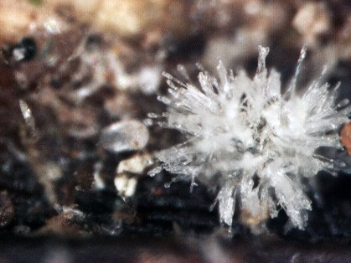
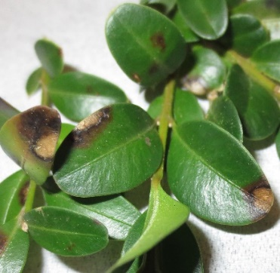
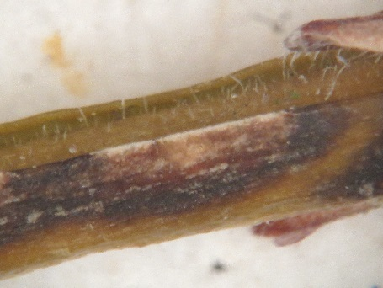
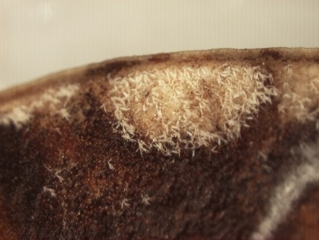
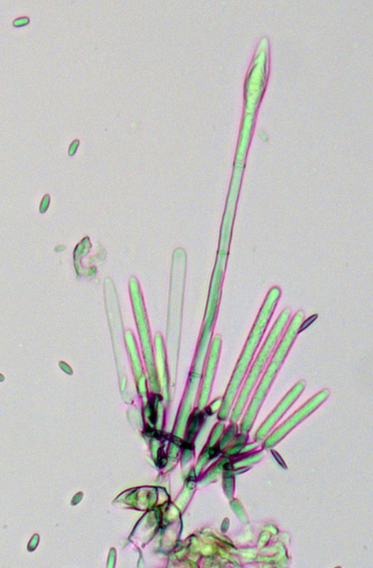
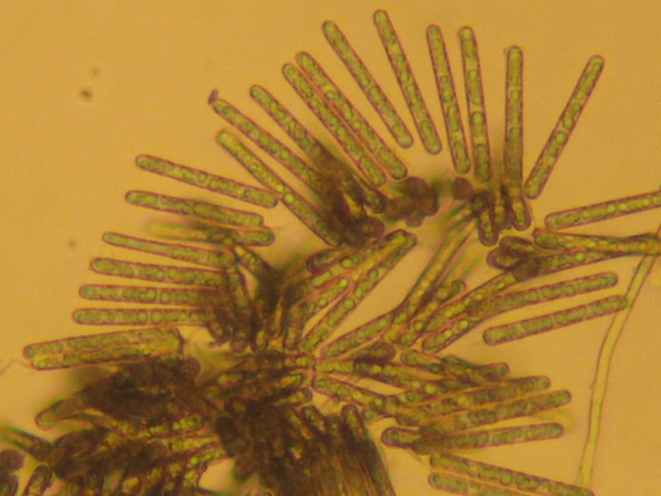
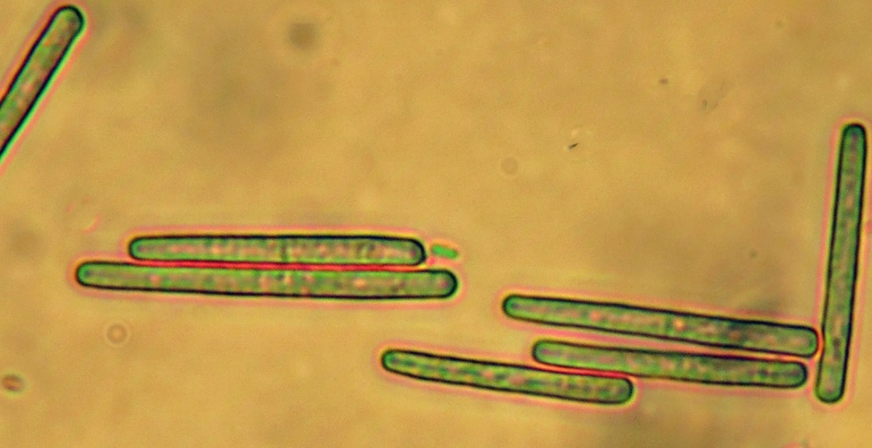

Slide 6
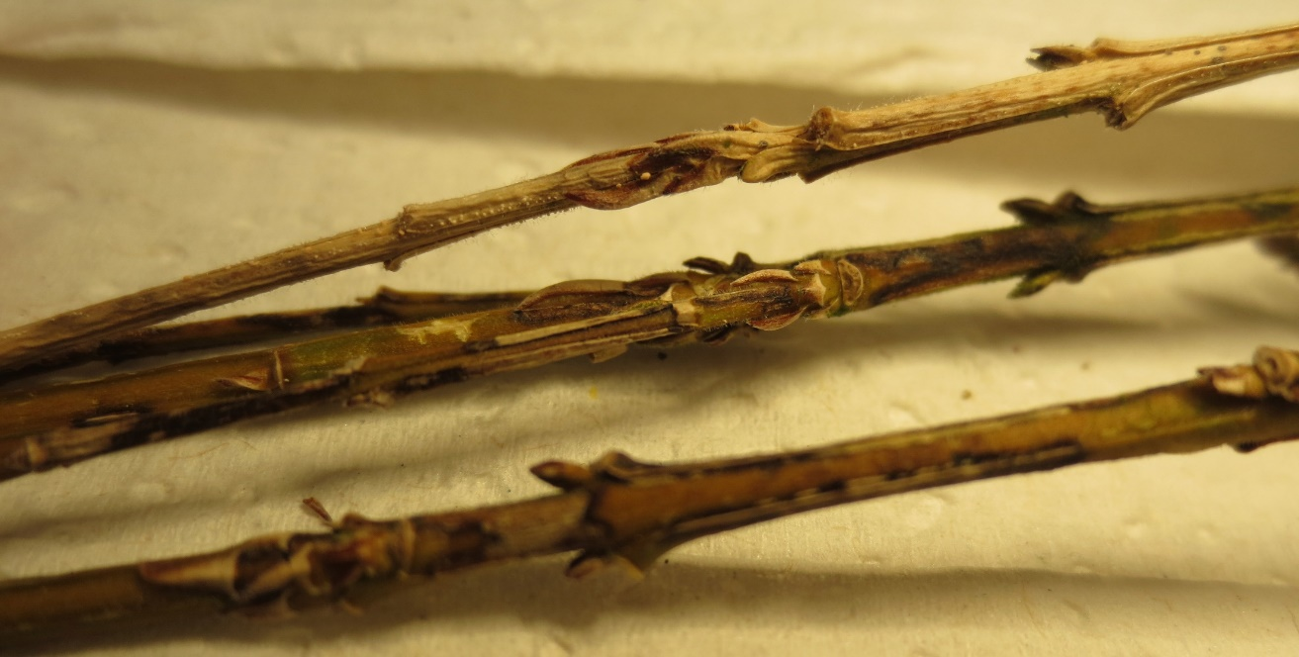
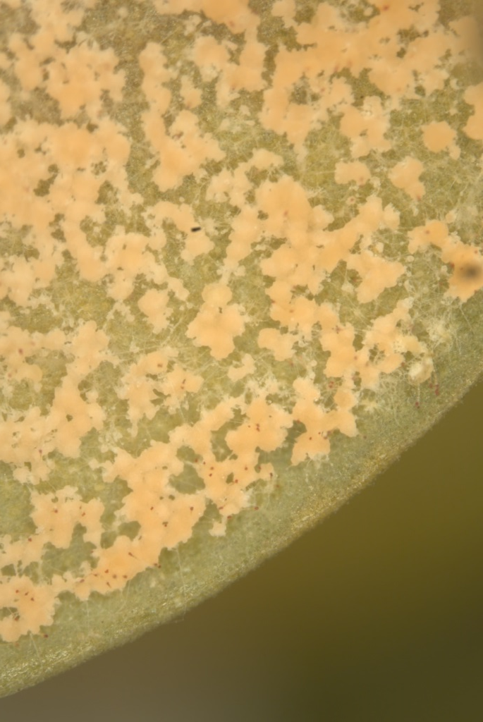
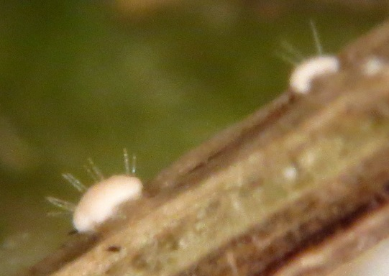
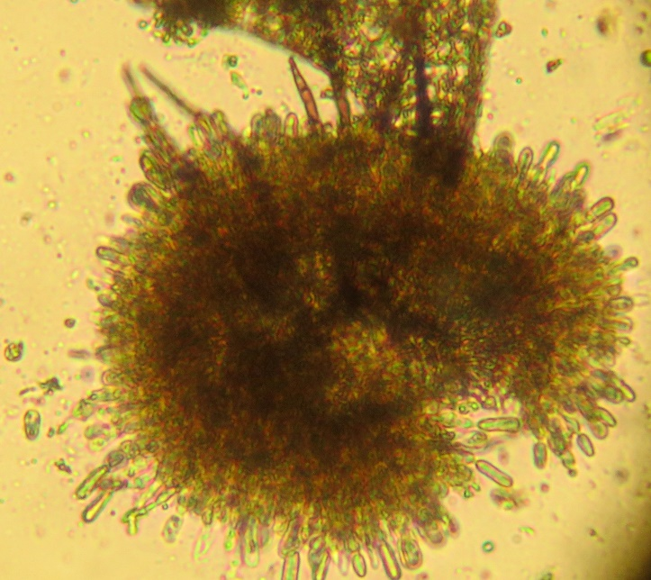
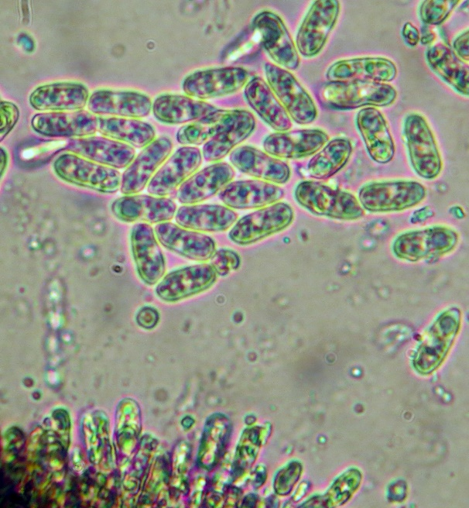
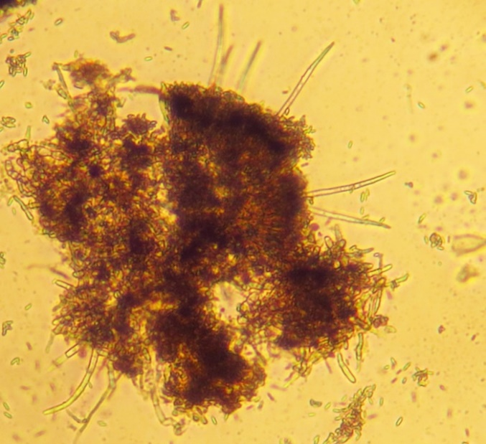
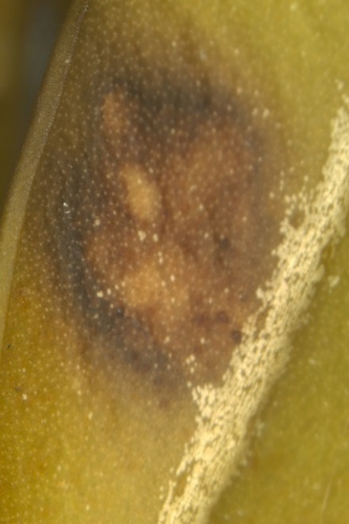
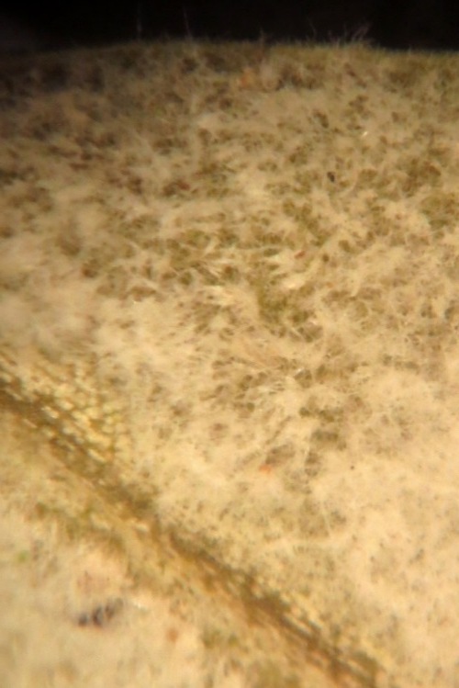
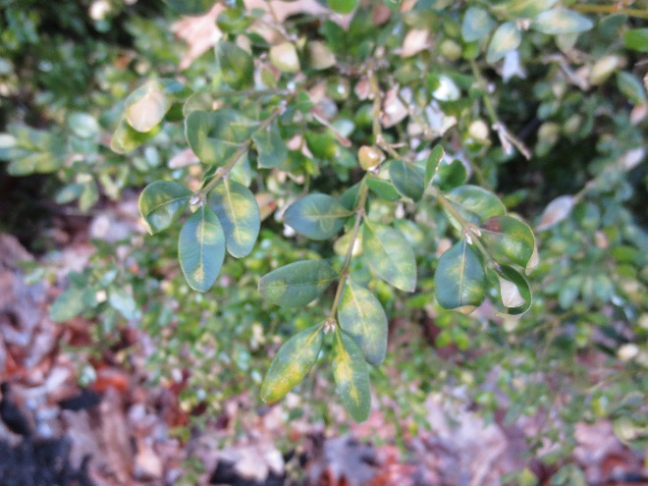
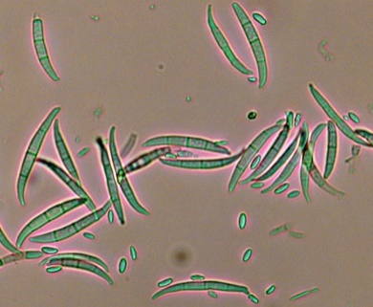
Volutella
Colletotrichum
Volutella
Colletotrichum
Volutella
Colletotrichum
Leaf miner
Fusarium

